Slide 1
How the Métis came to be
As the fur trade moved further west during the mid to late 17th century, many fur traders (particularly French and Scottish) especially those with the Northwest Company married First Nations women, particularly in the area that is now modern Manitoba
Why do you think they did this?
The fur traders believed it would ensure trade loyalty, while for the Natives, it would improve the living standard of their women and children

Slide 2
How the Métis came to be
Because the region was so isolated from more settled areas, the children of these French/Scottish and Native marriages often married other people of similarly mixed race
Over generations, they began to develop a unique culture, one that contained elements from both French and Native culture: the Metis.
Most Metis spoke both a First Nations language and either English or French, making them invaluable to the fur trade
The Metis also developed a unique language called Michif, which was a mix of multiple First Nations languages and French

Slide 3
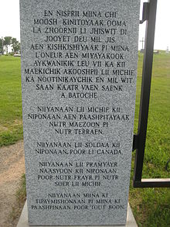
An example of Michif

Slide 4
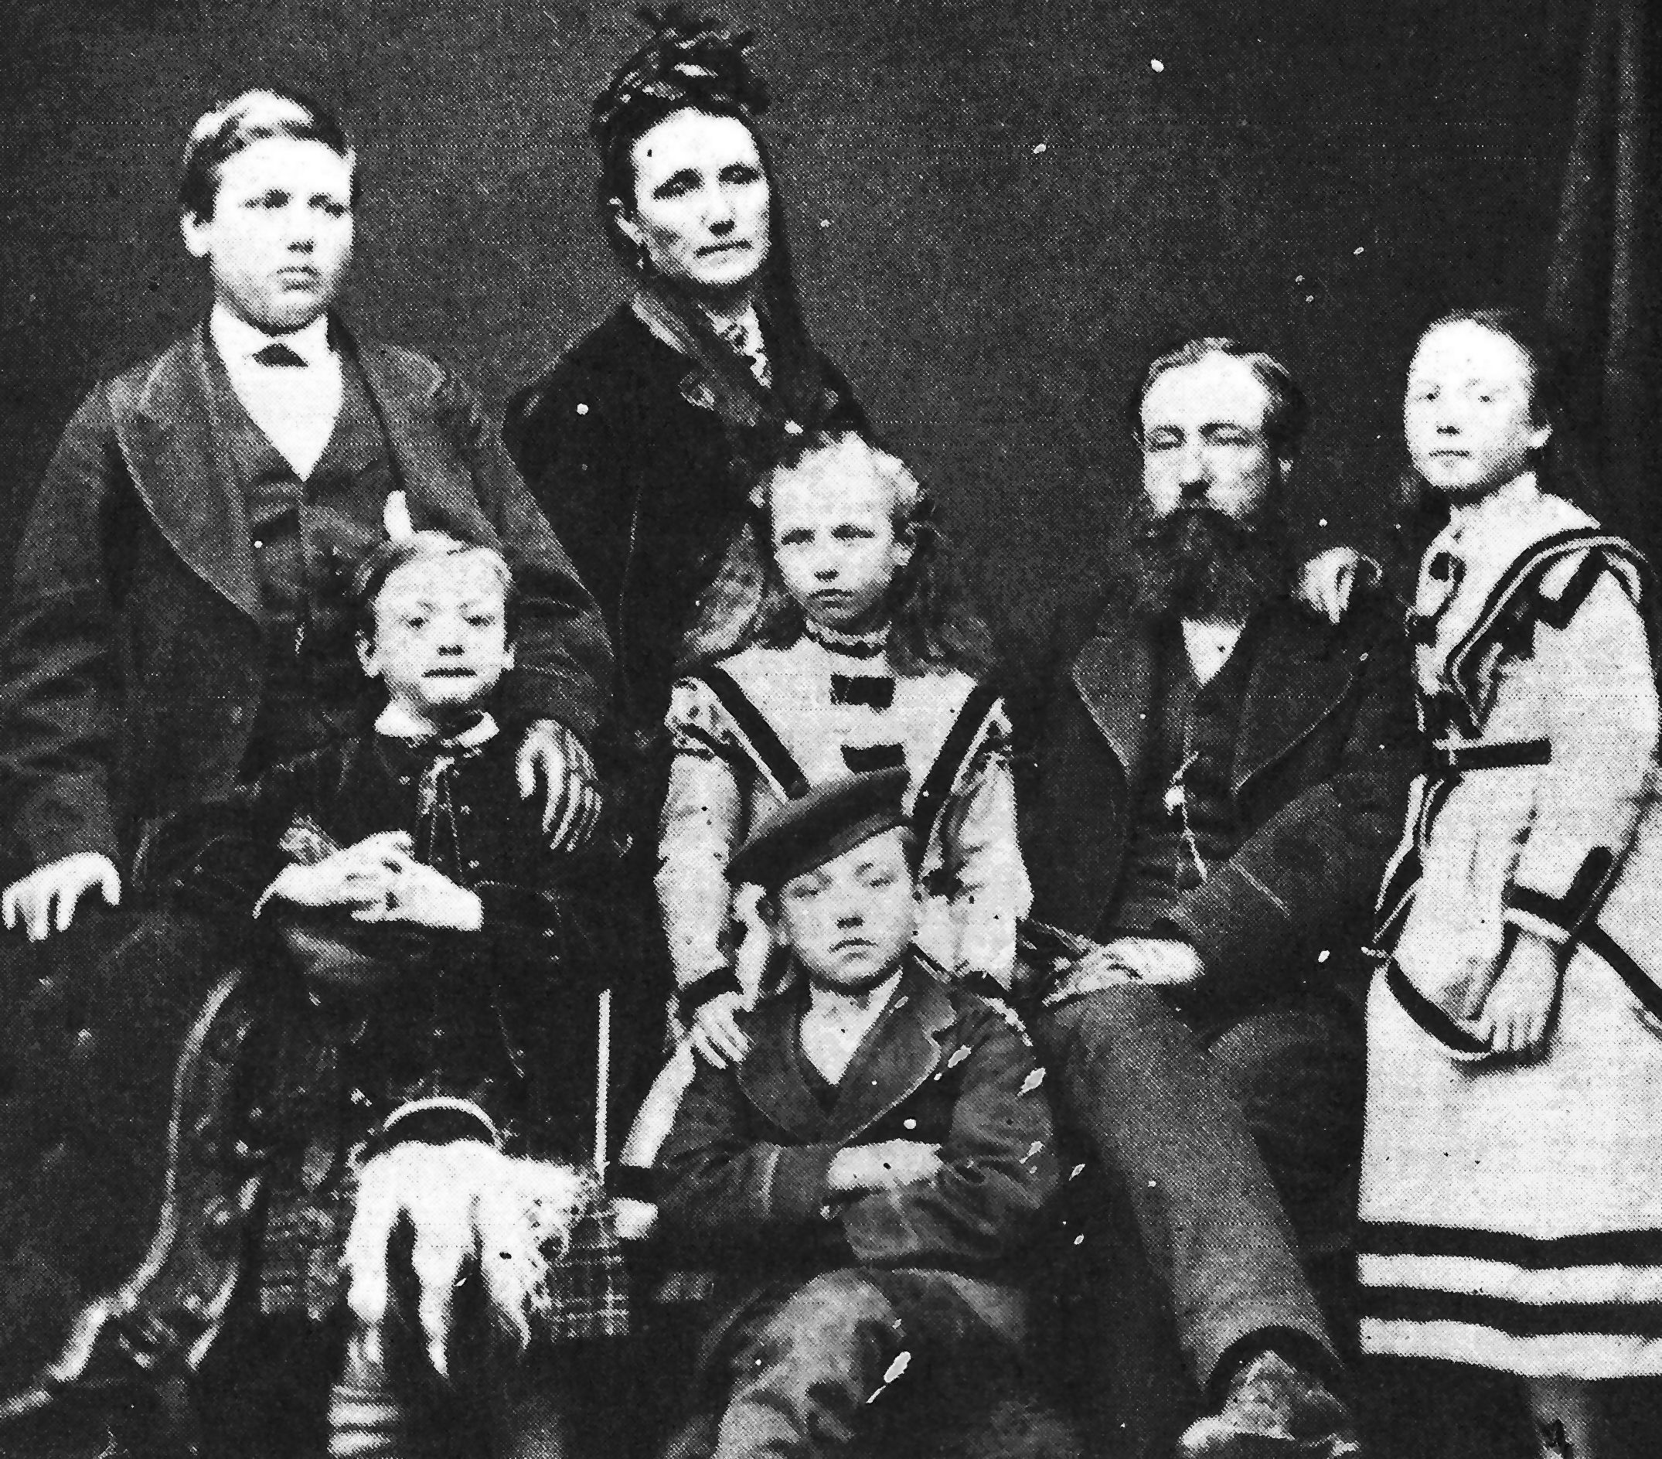
What about this picture tells you the family is Métis?

Slide 5
How the Métis came to be
Though there were Metis throughout the Northwest region, many were living near where the Red River and Assiniboine Rivers
What modern city is at this location?
This region had rich soil, and the Metis built farms according to the seigneurial system from New France
What was the seigneurial system?

Slide 6
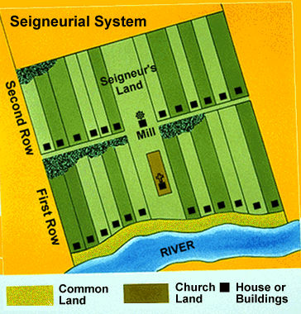
The seigneurial system

Slide 7
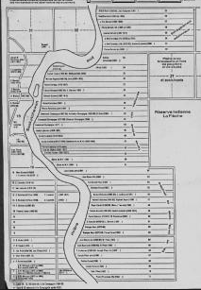
Red River Metis Lots

Slide 8
Trouble in Scotland
Many wealthy landowners in Scotland decided to kick their tenants off their land, knock down their houses and fences, and put huge flocks of sheep there. Wool was in high demand, and they could make more money.
Imagine you are a tenant farmer who has just been evicted from your farm by your landlord to make room for sheep; what can you do? What are your options?
Well…? Where are you going to live? What are you going to do to earn a living?

Slide 9
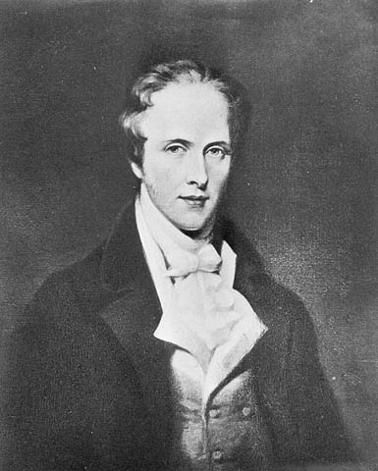
Meet Lord Selkirk and learn about his plan to help the evicted farmers in Scotland.

Slide 10
The Red River Colony plan
Lord Selkirk was a rich man who wanted to help tenant farmers who had been evicted from their lands.
He owned a majority of the shares in the HBC, and was a director in the company. His plan was to use his HBC earnings to create settlements specifically for those farmers in British colonies in North America
He wanted to create a colony in the fertile Red River Valley where settlers could farm enough food to both support themselves and supply HBC employees with food in Canada.
Why do you think he wanted to do this? Remember that Selkirk was an HBC director himself,
What problems can you see with this plan? Consider the location in particular

Slide 11
The Red River Colony
In 1811, the HBC gave Lord Selkirk about 300,000 square km in what is now south Manitoba/North Dakota
No one considered that the Metis and other people had already been living there for many years
What problems can you see this causing?

Slide 12
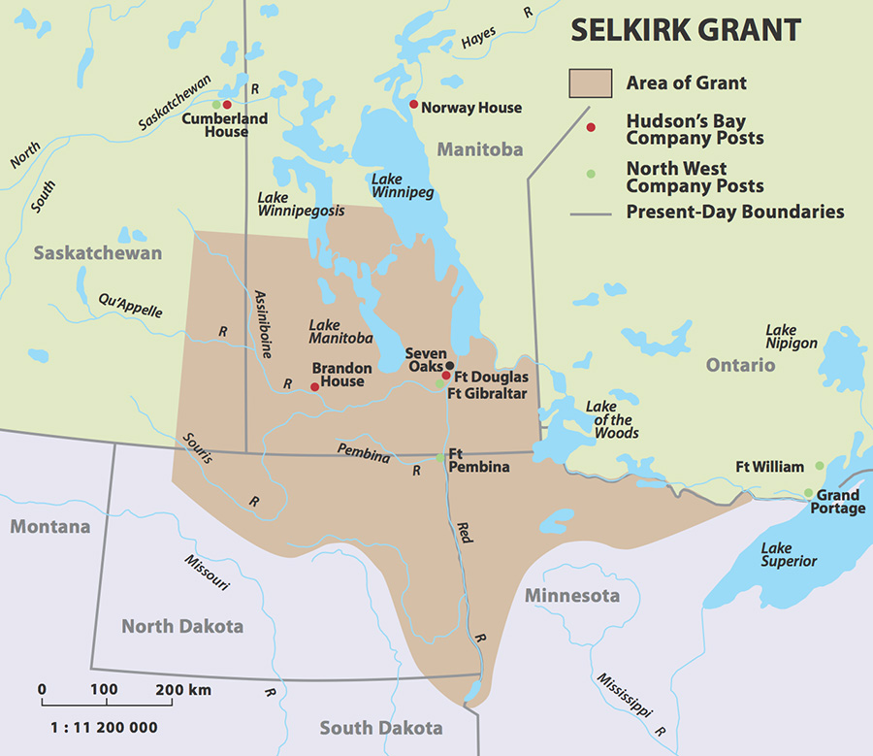
The Red River Colony

Slide 13
The Red River Colony
Conditions in the colony were extremely harsh; the climate was much colder than the Scottish farmers were used to
The first group of settlers left Britain in 1811, followed by a larger group in 1812, but neither arrived at the intended site of the colony until 1813 due to having to spend the harsh winter at York Factory, 850 km away
The first set of crops that the settlers had planted failed, forcing them to march and spend the winter at another HBC post
The next group of colonists that arrived landed by mistake in Fort William in Ontario, upon which they marched nearly 1000 km in the middle of winter to York Factory

Slide 14
The Red River Colony
When the settlers finally arrived at the colony they realized that they were totally unprepared. There were no houses, no fields ready, no seeds to plant…starvation was certain.
However, the settlers were not alone. The Metis settlements were nearby, and many Metis helped the settlers (shelter, and food). Many others did not help.
Why might the Metis at Red River not like the new settlers?

Slide 15
The Red River Colony
Many Metis were angry at the settlers! They didn’t like the HBC, and these settlers represented that company. They were seen as a threat to the Metis way of life…(they might drive the buffalo away!)
The NWC saw this colony as a plot by the HBC to ruin their trade, the local Metis sided with the NWC and together they decided to drive the colony from the country. Many Metis were angry at the settlers! They didn’t like the HBC, and these settlers represented that company. They were seen as a threat to the Metis way of life…The NWC encouraged the Metis to openly attack the settlers.

Slide 16
Exit Slip: Letters home
Imagine you are one of the original settlers in Red River
Write a letter home to a friend who is also a tenant farmer that has been evicted from their farm
You must either convince them to join you in Red River or to stay in the British Isles
Remember, their alternative would be moving to a city to become a labourer in a factory or mine
Your letter should be at least 2-3 paragraphs (no more than 3) and use the information you’ve learned today

