Slide 1
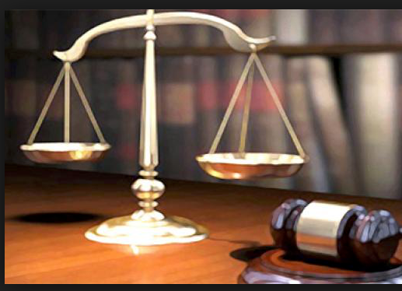
Arrest to Trial
© 2015 Cengage Learning

Slide 2
You’ve been Lawfully Arrested
The police will either hold you in custody or let you leave the police station.
In many situations the police will charge and then release you on a promise to appear or an undertaking, which may have certain conditions for you to follow.
Undertaking: An undertaking is a piece of paper that an accused signs instead of being held for a bail hearing. Usually it will contain conditions you agree to comply with as part of your release from custody. If you don’t follow the conditions of your undertaking you can be charged with failing to comply. Common conditions include abstaining from consuming or possessing drugs or alcohol, or promising to stay away from certain people or places.

Slide 3
You’ve been Lawfully Arrested
Recognizance:
This is a type of release from custody. If you've been released from custody after a bail hearing, you will get a recognizance of bail. This document states the terms under which you have been released. It says when you must go to the court. It may also include conditions of your release. For example, you may be required to be home during certain hours. A recognizance requires you or your surety to pledge a specific amount of money as a security before you're released.

Slide 4
You’ve been Lawfully Arrested
If the police decide to hold you in custody at the police station, they must bring you to a justice of the peace for a bail hearing within 24 hours of arrest, or as soon as possible. At the bail hearing, the justice of the peace will decide whether you should be released, or held in custody until trial.
You are entitled to have a lawyer represent you at the bail hearing.
If you are released, the justice of the peace may impose certain conditions and may require that you have a surety to sign on your behalf.

Slide 5
Preliminary Hearing
The court will decide if there is enough evidence to proceed.
First Appearance: DISCLOSURE:
This is the information that the police and Crown have about your case. The Crown must give you all the disclosure they have about your case. The disclosure may include:
police officer’s notes
witness statements
surveillance video and photos
financial documents
medical records
It will be given to you on an ongoing basis as it made available to the Crown by the investigating police officers. You may have to go to court more than once to get all of your disclosure. You should wait until you have all of your disclosure before deciding whether to plead guilty.

Slide 6
Second Appearance
Within 90 days…the accused needs to decide the next step.
Plead Guilty
Plead Not Guilty
Or accept a court resolution:
A resolution is a way of handling a case without going to trial. For example, if you qualify for resolution:
Your charges may be stayed or withdrawn.
You may be required to make a charitable donation or do community service work.

