Slide 1
Red RIVER RESISTANCE
Manitoba and the Metis Perspective

Slide 2
Red River Resistance
1869= Canadian government surveyors arrived in the Red River Area.
Metis upset because the boundaries of their long, narrow river lot farms were being ignored as the land was being surveyed into square blocks.
Metis > Decided to put a stop to this by taking away the chains that were being used by the surveyors
Metis > Also anger with the governments decision to appoint William McDougall as governor of the North West Territories.
McDougall = Favoured westward expansion and was for sending the land surveyors

Slide 3
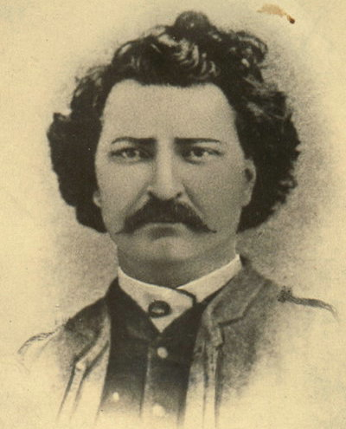
Enter > Louis Riel
Louis Riel emerged as the leader of the Metis during this time period.
Born in the Red River Settlement
Well educated
Persuasive speaker who was fluent in both English and French
Notes:
PLAY VIDEO
https://www.ssyoutube.com/watch?v=t5YrtvO7FDs&t=185s

Slide 4
National Committee of Metis
Louis Riel = the secretary of committee
Purpose of the committee = was to bargain with the Canadian government for lands, language, and religious rights of the Metis people
Goal = to stop the newly appointed governor, William McDougal, from entering and taking control of the Red River area
Metis did not think that McDougal had any right to enter the Red River Settlement
Official transfer of Rupert’s Land to Canada had yet to take place

Slide 5
National Committee of Metis
McDougal acted before official government instructions and attempted to enter the Red River Settlement
Metis reaction = 14 armed Metis blocked McDougal and then seized Fort Garry (HBC headquarters in Red River)
The Metis now had control of the settlement
Riel invited both French and English speaking Metis to an assembly at Fort Garry
At this meeting the Metis wrote a List of Rights > the conditions by which they would join Canada

Slide 6
Metis List of Rights
TASK =
>Get into groups of 4 and move desks together
>List the rights you think the Metis would have listed regarding their conditions for joining Canada.
>Things to keep in mind =
Metis language, culture, and traditions
Government structure and provincial control
Connection to rest of Canada
Land recognition and rights

Slide 7
Metis List of Rights
Compare group lists with the actual Metis List of Rights on page 220.
TASK=
> Look for similarities/differences between your group list and actual list
> What items on this list do you think the Canadian government would accept or discard ? Why?

