Slide 1
Canada: The nation expands
From Other Perspectives

Slide 2
Questions About Land
Land belongs to whomever is there first
Yes= Standup
No= Stay Seated

Slide 3
Questions About Land
People need to have official documentation to prove they own land
Yes= Standup
No= Stay Seated

Slide 4
Questions About Land
Land should be shared by everyone who is on it
Yes= Standup
No= Stay Seated

Slide 5
Questions About Land
People who are already living in an area should be consulted before changes are made
Yes= Standup
No= Stay Seated

Slide 6
Questions About Land
People should have the option of whether their area becomes part of a larger entity or country
Yes= Standup
No= Stay Seated

Slide 7
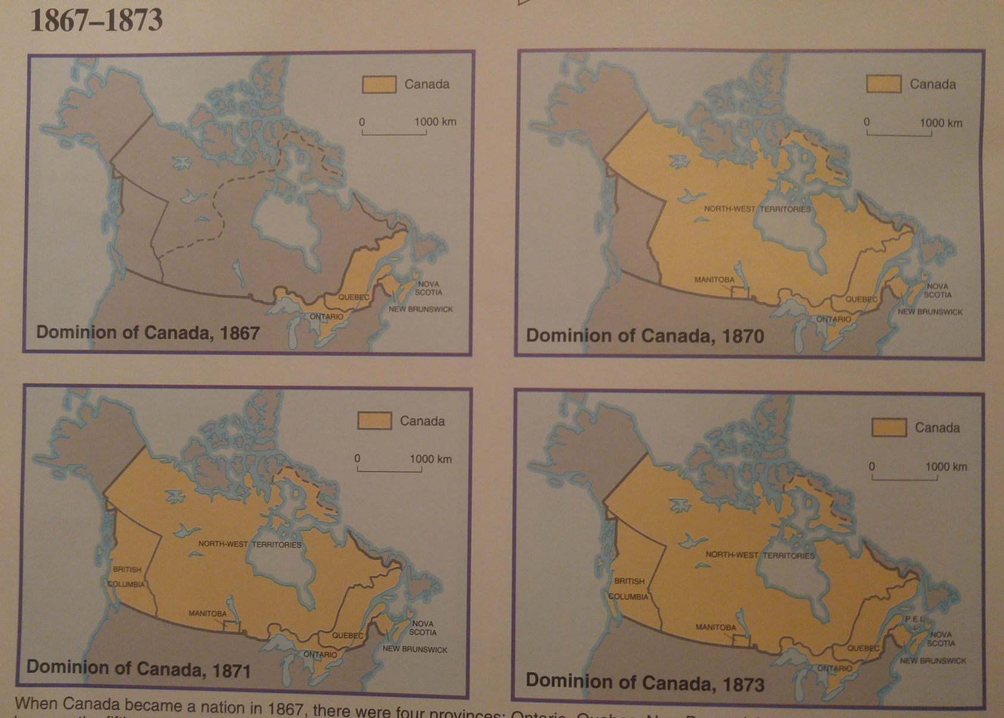
The Growth of Canada, 1867-1873
Notes:
Wrap Up Confederation and Colony group activity > In 1867, the British North America of NB, NS, and the Province of Canada (East and West) agreed to join together to form a nation that would be a federal union.
The members in this union would retain some power over their own affairs and would turn some over to a more powerful central government.

Slide 8
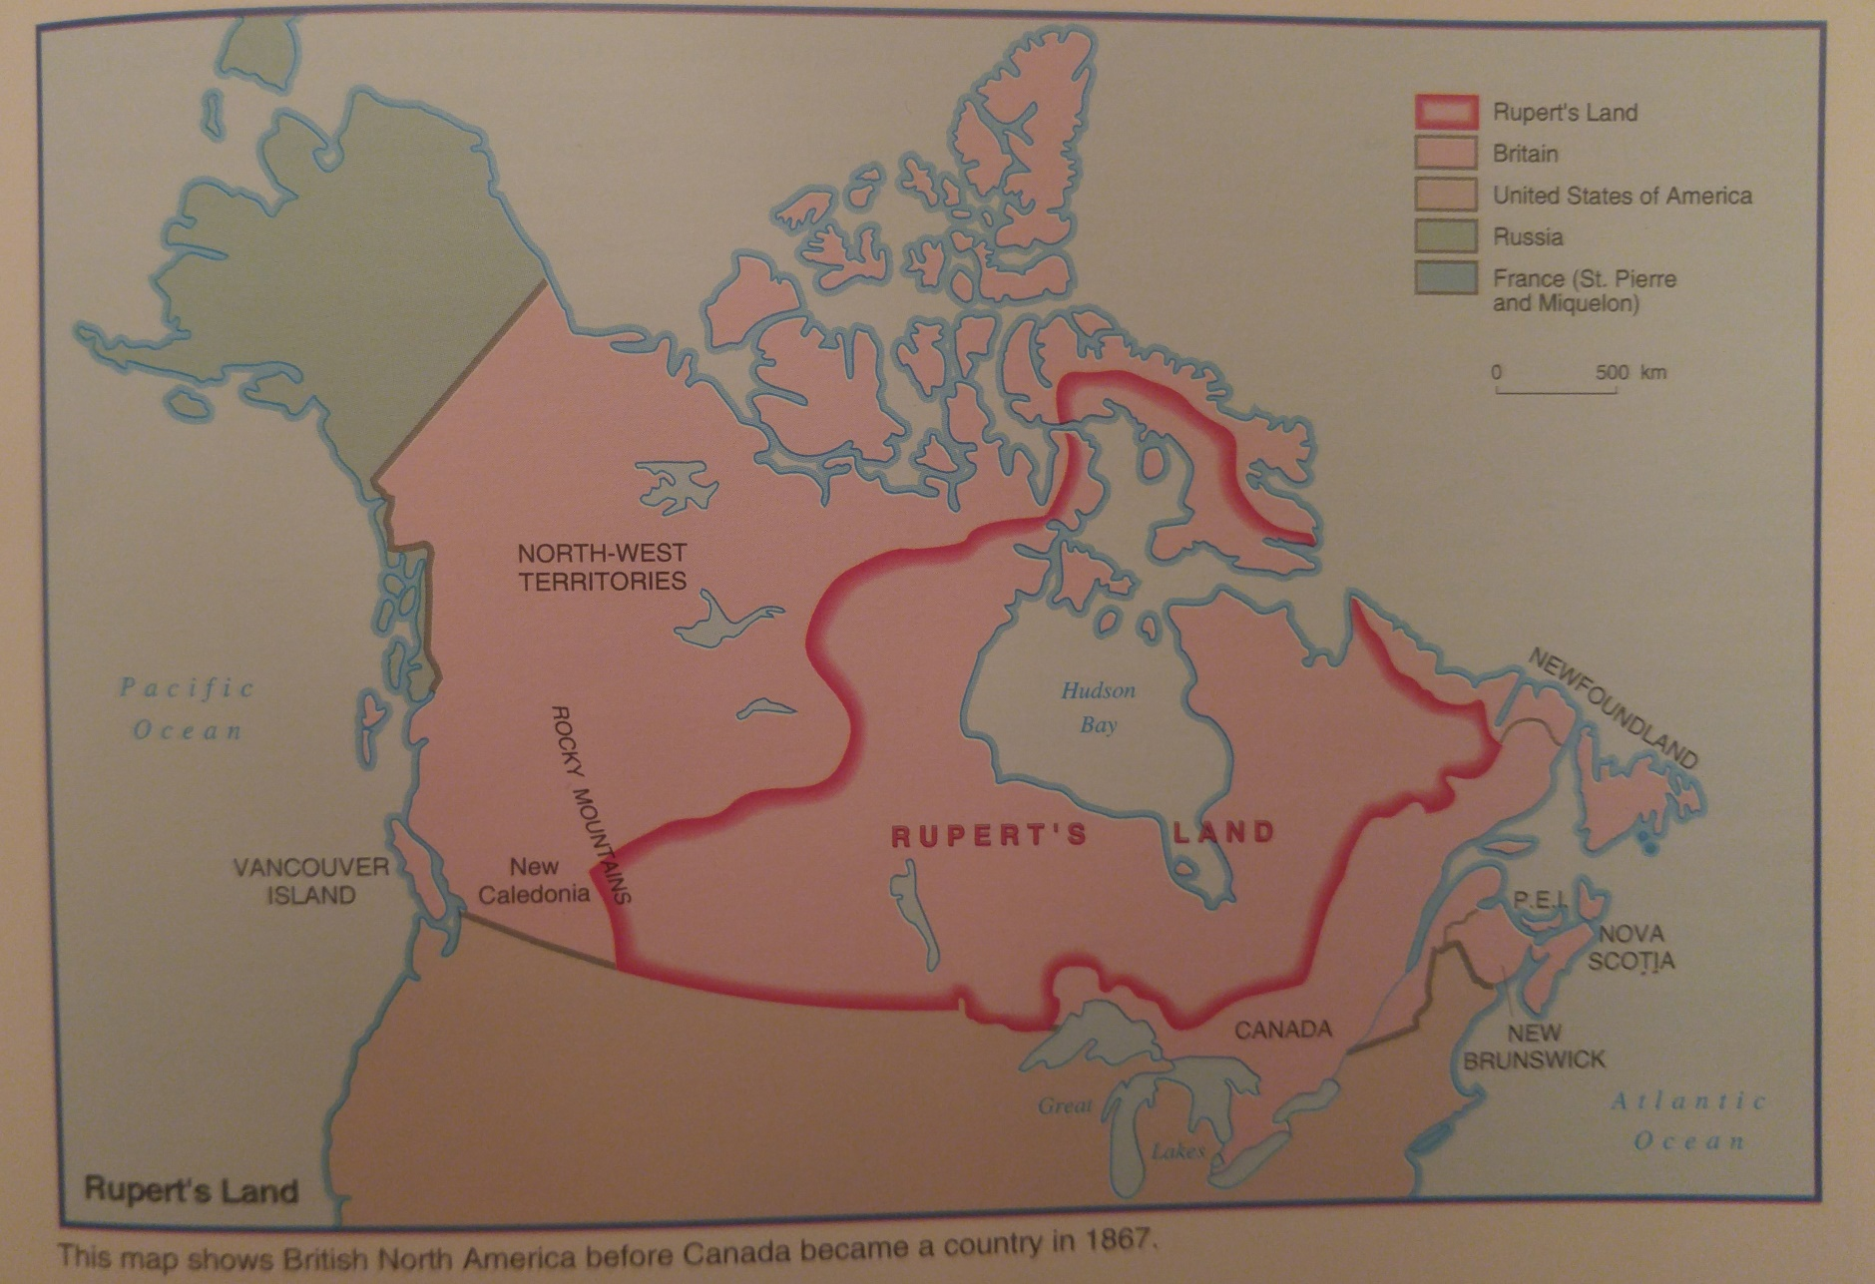
Rupert’s Land

Slide 9
Rupert’s Land > Key Points
Vast 7 770 000 square kilometre area west of the Dominion of Canada
Rupert’s Land = all of the territories that were granted to the Hudson’s Bay Company in 1670
In 1870 > Approximately 30 000 to 40 000 Native peoples living in Rupert’s Land
These Native peoples were spread out over this huge area and had different cultural characteristics

Slide 10
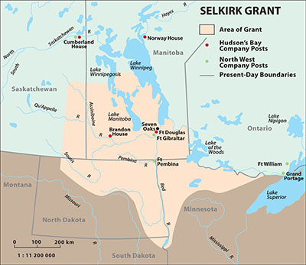
The Red River Settlement

Slide 11
The Red River Settlement >Key Points
Important Area Because:
Popular trading routes (HBC and NWC for furs; Metis for Pemmican)
Lord Selkirk secured a land grant of 300 000 square km in the valley of the Red and Assiniboine rivers (Present day Manitoba)
WHY Did He Buy?
>He was concerned about Scottish farmers who were being displaced from their lands and therefore decided to use his own money to help them settle in new Canadian areas.
Notes:
Lord Selkirk = Rich Scottish nobleman

Slide 12
Selkirk’s Settlers (Red River Valley)
1811= approximately 80 Scottish settlers arrived in Red River Valley and faced many problems (limited crops, cold winter, etc.)
Settlers survived mainly because of the help they received from the First People and the local Metis.
Conflict > Selkirk’s Settlers met with great opposition:
> Nor’Westers (NWC)= Angered because they thought the HBC (and new settlers) were trying to purposely disrupt trading practices and block supplies
>Metis= Felt that the Selkirk settlers would bring an end to their traditional hunting patterns (buffalo hunt).

Slide 13
Conflict Continued
Despite their worries, Metis were helpful to the new Selkirk settlers by providing them with food and assistance.
Metis came to realize that the Selkirk settlers would eventually try to take their land.
*Metis land> they had no legal rights or title to the land even though they had farmed it for generations.

Slide 14
Conflict Continued
“Pemmican Proclamation”:
Selkirk settlers desperate and starving
Governor of Red River (Assiniboia) issued the Pemmican Proclamation > Stated that for the next year no food could be taken from Assiniboia without a license that only he could issue.
Metis Angry:
Huge producer of pemmican and sold it to traders
Pemmican = huge source of income for Metis
Metis felt that the Governor had no right to pass laws on their land

Slide 15
The Metis (Before Confederation)
Metis = Largest group of people in the Red River Settlement (4000 in 1843)
Metis nation began when English, Scot, or French fur traders married Indian Women
Had varied cultural backgrounds and drew upon all of these cultures (English, French, and Indian)
Metis people had developed distinct culture and ID over the years because they had little contact with Ontario and Quebec.
Supported themselves in many different ways:
Fur trade> Fur posts; interpreters; company clerks
Fur Trading Companies > Hunters, trappers, “tripmen”
Notes:
“Tripmen” >Transported goods and furs to and from the fur forts, or as freighters in brigades of Red River carts
Metis Culture https://www.ssyoutube.com/watch?v=63t_PDRtCL8&t=4s

Slide 16
The Buffalo Hunt
Important part of Metis life and culture
Major source of food and other resources
Hunt was opportunity for the hunters to display their hunting skills and earn admiration/ respect
Took place at least once a year
Strict rules of conduct for these hunts:
No hunting on Sunday
No one was to lag behind, go ahead, or off in a different direction
No one was to start the buffalo hunt before the order was given
Anyone caught stealing was to be publicly humiliated
Notes:
PLAY VIDEO
https://www.youtube.com/watch?v=h9kQtd4_WcU

Slide 17
Metis Uses for Buffalo

Slide 18
Metis Uses for Buffalo

Slide 19
Metis Farms
Usually in strips about 3 km long
They often had 100 metre frontage on the rivers
These long and narrow farms allowed each farmer to take his animals to the river to drink and to the meadow to eat hay
Most of these farms had not been bought. The Metis farmers simply settled down and begun working them. This kind of ownership was recognized as being valid.

Slide 20
Metis Farms

Slide 21
Metis Farms

Slide 22
Canada’s Interest in Rupert’s Land
Why Canadian Government was interested in Rupert’s Land:
There was very little good farm land left to buy in Ontario (Rupert’s Land had a lot)
Canadian Government had strong desire to expand country westward and reach their goal of spanning from the Atlantic Ocean to the Pacific Ocean
Moving into Rupert’s Land help achieve this goal and also keep the U.S. out

Slide 23
The Rupert’s Land Act, 1868
The Canadian government decided to buy Rupert’s Land for from the HBC for $1 500 000
After gaining control of the area, the government called the entire area the North-West Territories
Government Surveyors:
Government sent people to the area to begin surveying the land for the location of townships
These townships were to be in traditional large square/ blocks (similar to system used by the people in Ontario)
Notes:
The people of the Red River Settlement , both the settlers and the Metis, were surprised to see the surveyors.
No one from Ottawa had ever been sent out to ask the people for their opinions about becoming part of Canada, or even to inform them of the government’s plan.

Slide 24
Square Township System

Slide 25
Farm Comparison

